Slide 1

Interpreting Deep Learning-Based Networking Systems
Zili Meng, Minhu Wang, Jiasong Bai, Mingwei Xu, Hongzi Mao, Hongxin Hu
Tsinghua University
Massachusetts Institute of Technology
Clemson University
Notes:
[Click]
Hello everyone, I’m Zili from Tsinghua University. I’ll be presenting our work “Interpreting deep learning-based networking systems”. This is a joint work with Minhu, Jiasong, Mingwei from Tsinghua, Hongzi from MIT, and Hongxin from Clemson.

Slide 2

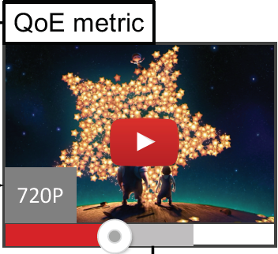
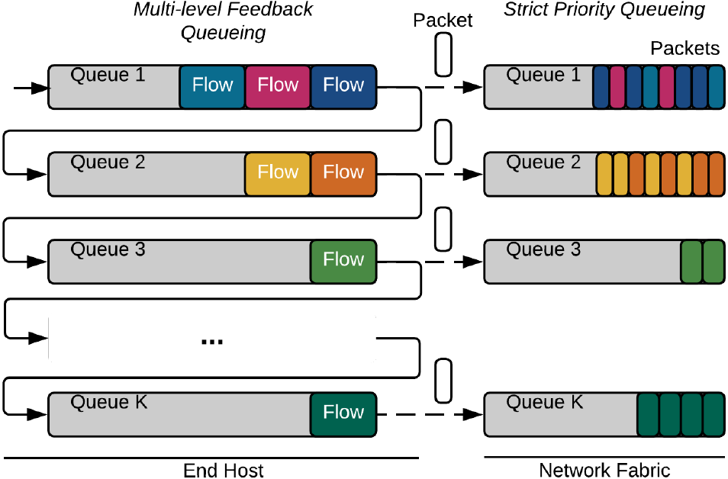
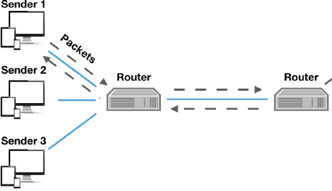
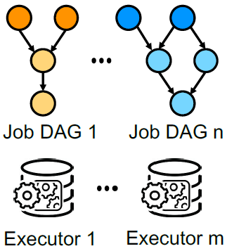
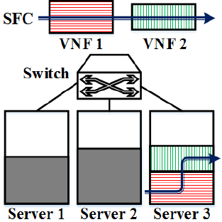
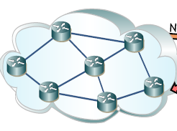
Deep Learning-Based Networking Systems
Tput matching BBR
Latency↓ 33-48%
(ICML’19)
QoE↑ 12~25%
(SIGCOMM’17)
Client-Based
Video Streaming
FCT↓ Up to 48%
(SIGCOMM’18)
Congestion Control
Adaptive Video Streaming
Switch Flow Scheduling
JCT↓ At least 21%
(SIGCOMM’19)
Delay↓ 31-53%
(SOSR’19, JSAC’20)
Throughput↑ 33%
(IWQoS’19)
Cluster Job Scheduling
SDN Network Optimization
Service Chain Placement
Notes:
Before talking about the interpretation, let’s first give a quick look at the existing deep learning-based networking systems. With the emergence of deep learning, many networking systems start to employ deep learning algorithms, and some are even being deployed in the industrial applications.
[Click]
And the reason is quite straightforward. Deep neural networks can offer much higher performance than heuristic algorithms. These work has performance improvements of around 30% on average.

Slide 3
















Problem 1: How to Design?
Network operators do not have enough knowledge on deep learning.
?
$$r^{t}$$
$$p_{300}$$
$$r^{t}$$
$$p_{300}$$
$$B$$
$$p_{750}$$
$$B$$
$$p_{750}$$
$$⋯$$
$$⋯$$
$$⋯$$
$$⋯$$
$$T^{t}$$
$$p_{4300}$$
$$T^{t}$$
$$p_{4300}$$
Notes:
However, when deploying deep learning in networking systems, operators might confront a series of problems. The first is how to design the neural network structure themselves with limited knowledge in deep learning. From the view of network operators, how can we design a neural network to connect the observations and possible actions?
[Click]
A naïve solution might be a fully connected neural network, which is actually adopted by several projects on the last page.

Slide 4








Problem 1: How to Design?
Network operators do not have enough knowledge on deep learning.
$$r^{t}$$
$$p_{300}$$
$$r^{t}$$
$$p_{300}$$
$$B$$
$$p_{750}$$
$$B$$
$$p_{750}$$
$$⋯$$
$$⋯$$
$$⋯$$
$$⋯$$
$$T^{t}$$
$$p_{4300}$$
$$T^{t}$$
$$p_{4300}$$

Slide 5
Problem 1: How to Design?
Network operators do not have enough knowledge on deep learning.
$$r^{t}$$
$$p_{300}$$
$$r^{t}$$
$$p_{300}$$
$$B$$
$$p_{750}$$
$$B$$
$$p_{750}$$
$$⋯$$
$$⋯$$
$$⋯$$
$$⋯$$
$$T^{t}$$
$$p_{4300}$$
$$T^{t}$$
$$p_{4300}$$

Slide 6









Problem 1: How to Design?
Network operators do not have enough knowledge on deep learning.
$$r^{t}$$
$$p_{300}$$
$$r^{t}$$
$$r^{t}$$
$$p_{300}$$
$$p_{300}$$
$$B$$
$$p_{750}$$
$$B$$
$$B$$
$$p_{750}$$
$$p_{750}$$
$$⋯$$
$$⋯$$
$$⋯$$
$$⋯$$
$$⋯$$
$$⋯$$
$$T^{t}$$
$$p_{4300}$$
$$T^{t}$$
$$T^{t}$$
$$p_{4300}$$
$$p_{4300}$$
Notes:
Another design choice would be putting some critical variables near to the output layer.

Slide 7








Problem 1: How to Design?
Network operators do not have enough knowledge on deep learning.
$$r^{t}$$
$$p_{300}$$
$$r^{t}$$
$$p_{300}$$
$$r^{t}$$
$$p_{300}$$
$$B$$
$$p_{750}$$
$$B$$
$$p_{750}$$
$$B$$
$$p_{750}$$
$$⋯$$
$$⋯$$
$$⋯$$
$$⋯$$
$$⋯$$
$$⋯$$
$$T^{t}$$
$$p_{4300}$$
$$T^{t}$$
$$p_{4300}$$
$$T^{t}$$
$$p_{4300}$$

Slide 8

Problem 1: How to Design?
Network operators do not have enough knowledge on deep learning.
$$r^{t}$$
$$p_{300}$$
$$r^{t}$$
$$p_{300}$$
$$r^{t}$$
$$p_{300}$$
$$B$$
$$p_{750}$$
$$B$$
$$p_{750}$$
$$B$$
$$p_{750}$$
$$⋯$$
$$⋯$$
$$⋯$$
$$⋯$$
$$⋯$$
$$⋯$$
$$T^{t}$$
$$p_{4300}$$
$$T^{t}$$
$$p_{4300}$$
$$T^{t}$$
$$p_{4300}$$
Notes:
OK, so a third design choice might be adding preprocessing units to some inputs. There could be much more candidate structures.
[Click]
Note that despite they are equivalent when you consider the neural network as a blackbox, the fact is that neural networks with different structures have different training efficiency, which will affect the final performance. Network operators might not have enough knowledge to decide which structure is better.

Slide 9
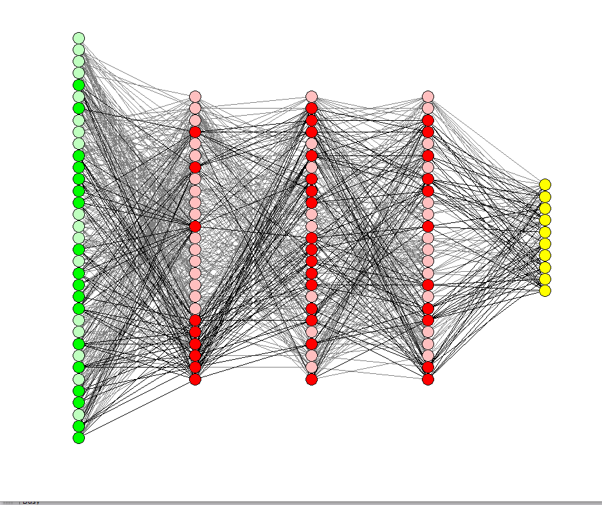
Problem 2: How to Debug?
When DNNs do not behave as expected…
Conventional
(e.g., Shortest Job First)
Starvation
DL-based
Action frequency
1 2 3 4 5
Aging
Notes:
The second question is how to debug and fix the problems in DNNs. Let’s look at this example. The x-axis is different actions, they can be the scheduling decisions of flows on a switch. And the y-axis is the distribution of different actions made by the DNNs.
[Click]
Now something seems not working well. One of the action is almost not chosen. So there might be something wrong with the decision-making algorithm.
[Click]
If the decision-making algorithm is a conventional one, say the shortest job first scheduling, operators might realize that “oh, it’s starvation” by discovering that it’s always the longest job that is not selected. Therefore, they introduce the aging mechanism and fix the problem.
[Click]
But when it comes to a deep learning-based algorithm, due to the massive number of neurons, how can network operators know which part of neural networks goes wrong?

Slide 10
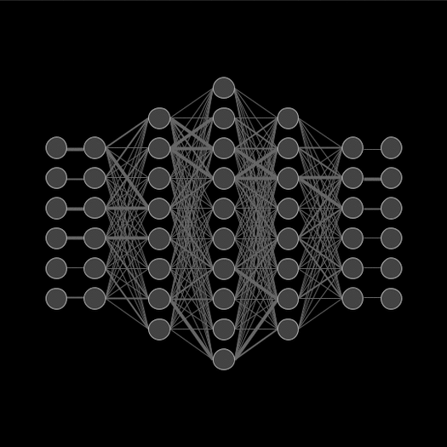

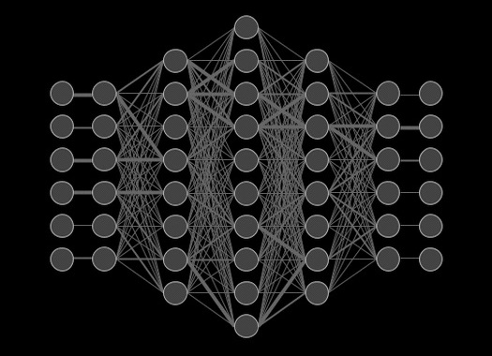






Problem 3: How to Deploy?
For networking systems, DNN…
High resource consumption
Long decision latency
Computation
Memory
Storage
x10ms
Notes:
The third question is how to deploy those systems onto network devices.
[Click]
The first barrier is the resource consumption of neural networks, specifically, the resource consumption at the inference stage.
[Click]
Many networking systems are deployed on in-network devices, such as switches and middleboxes; or on end devices, such as mobile phones and smart TVs. And many of those devices are resource limited.
[Click]
For example, when we’re trying to deploy a DNN onto the dataplane of a switch, we can only figure out that even doing float number calculation is very difficult, needless to say deploying a neural network. The computation ability, memory and storage of network devices do not match the need of deep learning.
[Click]
The second barrier is the long decision latency of neural networks. Let’s consider a case of deep learning-based datacenter switch scheduling. If network operators want to optimize the scheduling decisions at the per-flow level, what would the control loop be like?
[Click]
When the first packet of a flow arrives, the switch will report the information of that flow to the neural network.
[Click]
Then it will compute the scheduling result. The inference of neural networks usually takes tens of milliseconds.
[Click]
During this time, packets of this flow are still being processed by the switch with some default rules. When the scheduling decisions finally come back after tens of milliseconds, most flows in the datacenter have already run out. The performance of deep learning-based networking systems might therefore be degraded.

Slide 11
Problem 4: How to Adjust?
Frequent ad-hoc adjustments when running a service online…
1
8
Conventional (e.g., Shortest Path):
Recompute!
DL-based:
Recompute? Are DNNs robust enough?
Manually adjust? Which path is better?
0
3
7
11
9
4
6
13
10
12
2
5
Notes:
Finally, operators might do frequent ad-hoc adjustments to the existing rules of networking systems, such as routing reconfigurations. One more question would be how to ad-hoc adjust the DNN-based rules according to specific requirements?
[Click]
Let’s see an example of a deep learning-based routing optimizer. The neural network has already decided the routing path for two flows, as shown in the figure.
[Click]
Now the network operators want to migrate flows from the link between node 7 and 10, due to some reasons such as pricing or maintenance.
[Click]
If it’s a conventional routing algorithm, such as the shortest path routing, network operators can just recompute the second optimal paths for those affected demands and reinstall the routing rules.
[Click]
But if it’s a deep learning-based routing algorithm, can we simply recompute? In the shortest path algorithm, the routing decision of a flow will not affect another flow. But for neural networks, this can not be guaranteed since they are not stable and robust to the input.
[Click]
Other unrelated flows, such as the green flow in the figure, might also be affected in the recomputation and need to be migrated, which will increase the migration cost.
[Click]
Well, manually adjusting the routing paths is also very difficult, because we do not know why the DNN makes such a routing decision. Neither do we know which candidate path is better.

Slide 12
DL-Based Networking Systems…
Difficult to design
Difficult to deploy
Difficult to debug
Difficult to ad-hoc adjust
Notes:
Now we know that DNNs are difficult to design, deploy, debug and ad-hoc adjust from the view of network operators…

Slide 13
DL-Based Networking Systems…
Difficult to ad-hoc adjust
Difficult to design
Difficult to deploy
Difficult to debug
Difficult to understand
Notes:
… and the root cause is network operators could not understand why deep neural networks make such decisions.

Slide 14






DL-Based Networking Systems…
More and more difficult to understand
Difficult to understand
The evolution of language models
Notes:
And moreover, it could becomes more and more difficult to understand. The application of DNNs in networking systems is still at a preliminary stage: the first successful application of DNN in sigcomm was published just 3 years ago. So let’s see what happened to other communities that using deep learning earlier than us.
[Click]
For example, the natural language processing. We can see that the number of parameters of language models has been keeping growing exponentially in recent years, from millions of parameters to billions of parameters. And the recently released GPT-3 model even reached a surprising number of 175 billion parameters. With the similar development from the other communities, larger DNNs in networking systems in the future will further aggravate those problems.

Slide 15
What if we can interpret DL-Based networking systems?
Notes:
What if we can interpret the behaviors of deep learning-based networking systems, and speculate how and why they make such decisions?

Slide 16

Let’s interpret DL-Based networking systems!
Notes:
Thus, I’m going to introduce Metis, a general framework that provides interpretability for networking systems, and therefore sheds light on the problems above.

Slide 17
Challenge: Interpret Diverse Networking Systems
Local Systems
Congestion Control
Adaptive Video Streaming
Switch Flow Scheduling
Global Systems
Cluster Job Scheduling
SDN Network Optimization
Service Chain Placement
Notes:
So here is a challenge: as we can see, there are many scenarios under the umbrella of networking systems, how can we interpret those diverse systems? Are there any similarities among them?
[Click]
Our observation is that we can briefly categorize them into two types: local systems and global systems. Local systems collect information locally and make decisions for one instance only, such as congestion control agents on end-devices. Global systems aggregate information across the network and make global planning for multiple instances, such as the software-defined network controller.

Slide 18
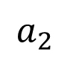
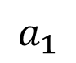
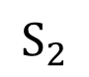
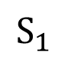
Local System Interpretation
Teacher-student learning
Policies in local systems
rule-based
simple
$$S_{2}$$
lightweight
expressive
Linear regression
Decision trees
Markov model
$$a_{1}$$
$$a_{2}$$
$$S_{1}$$
For more details, please refer to our paper.
Notes:
For local systems, we find that existing policies are usually rule-based with a simple decision logic. Therefore, our solution is to convert the neural networks inside those local systems into simpler and self-interpretable models.
[Click]
According to the recent advances in the machine learning community, there are many candidate models that could be the target of the conversion.
[Click]
Our design choice is to convert those policies to decision trees. The first reason is that decision trees are non-parametric and can represent very complex policies by design. The second reason is that decision trees are lightweight enough for networking systems, which we will later demonstrate. Moreover, the structure of decision trees also resembles the rule-based essence of local systems, such as the routing table.
[Click]
Therefore, we adopt a conversion method based on a teacher-student learning process. Operators still need to train a DNN first. The high-level idea of the conversion is that the DNN acts as the teacher
[Click]
and generates input-output samples to construct the decision boundary in the state space.
[Click]
The decision tree is therefore constructed according to the samples of the DNN. And for more algorithm details, please refer to our paper.

Slide 19
Global System Interpretation
Graph
Hypergraph
Notes:
For global systems, our observation is that we can formulate many of them with hypergraphs. So what’s a hypergraph?
[Click]
In a traditional graph, an edge connects two vertices. And in a hypergraph, a hyperedge can cover multiple vertices.

Slide 20


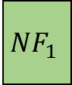
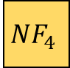
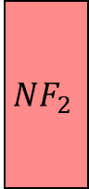
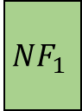
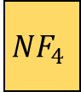

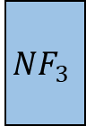
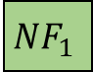
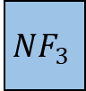
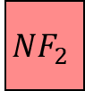
Global System Interpretation
a
1
b
2
3
4
Graph-structured input/output
c
d
e
5
6
7
8
f
g
Hypergraph
$$NF_{1}$$
$$NF_{4}$$
×
×
×
$$NF_{4}$$
×
$$NF_{1}$$
$$NF_{4}$$
Bivariate mapping
$$NF_{2}$$
×
$$NF_{1}$$
×
$$NF_{3}$$
×
×
$$NF_{3}$$
$$NF_{2}$$
×
Server1
2
3
4
Notes:
So why can many global systems be formulated into hypergraphs? We find two outstanding features of global systems: graph-structured inputs or outputs, and the bivariate mapping.
[Click]
Graph-structured input/output means that the inputs or outputs of global systems are graph-structured, such as the network topology. For example, in the routing results of a deep learning-based routing optimizer, we can formulate the interaction between routing paths and links as the relationship between hyperedges and vertices.
[Click]
Bivariate mapping means that the global system constructs a mapping between two variables, such as allocating resources to requests. In such case, the two variables can therefore be formulated as node and hyperedge.

Slide 21
Global System Interpretation
Performance Degradation
Interpretation Conciseness
Determinism
Hypergraph
For more details, please refer to our paper.
Notes:
With the hypergraph formulation, the next step is to find out which connection between hyperedge and node is critical to the optimization result. In the interest of time, I can’t go into the details.
[Click]
The high level concept is that we calculate the importance of every connection in the hypergraph to the optimization goal. Network operators can therefore use these information to understand why DNNs make such decisions. And to make sure that the interpretation results could be understood by operators, we have three metric to measure when calculating the importance of each connection.
[Click]
The first metric is the performance degradation. The critical connections found by Metis should be those connections that have a great influence on the output of the networking system.
[Click]
The second metric is the interpretation conciseness. Usually the number of interpretations that humans can understand is budgeted. Therefore, the number of critical connections should also be concise enough to be understandable for network operators.
[Click]
And the final metric is the determinism, that is to say, we expect each connection to be either critical or not critical. Otherwise, the crafty agent will learn to allocate all connections with the same importance and generate meaningless interpretations.

Slide 22

Interpretations – What do they look like?
Adaptive Video Streaming
(Pensieve [SIGCOMM’17])
r ^{t}<1.53
r ^{t}<0.52
r ^{t}<2.35
B<14.3
B<10.6
B<11.2
B<15.0
Switch Flow Scheduling
(AuTO [SIGCOMM’18])
θ ^{t}<0.85
B<15.3
T ^{t}<2.0
θ ^{t}<1.36
θ ^{t}<1.32
T ^{t}<8.7
θ ^{t}<2.26
T ^{t}<10.3
Variables
Visit frequency:
Bitrate frequency (kbps):
r ^{t}
θ ^{t}
B
T ^{t}
Last chunk bitrate (Mbps)
Last chunk throughput (Mbps)
Buffer occupancy (s)
Last chunk download time (s)
300
1%
4300
750
10%
SDN Network Optimization
(RouteNet [SOSR’19])
30%
60%
2850
1200
100%
1850
Notes:
Now I’ll show you a wide range of experiments that we did. We implement Metis onto three deep learning-based networking systems, including Pensieve, an adaptive bitrate system, AuTO, a switch flow scheduling system, and RouteNet, a network optimization system for software defined networking. Two of them are local systems, and the remaining one is a global system.
[Click]
The interpretations of Pensieve, as presented on the slide, is a decision tree. We can clearly see the decision logic of Pensieve:
[Click]
On the top two layers, Pensieve first classifies inputs based on the last chunk bitrate, or r^t, which is different from existing methods. Metis discovers that the information contained in the r^t affects the performance significantly.
[Click]
Later, Pensieve makes decisions based on buffer and throughput similar to existing heuristics. For interpretations of other systems, please refer to our paper.

Slide 23
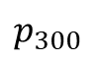


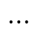
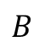
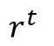


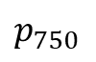

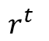
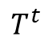
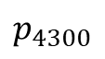
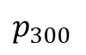


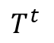


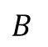
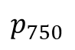


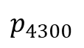
Case 1: Metis helps to design
Original
Test set: 5.1%↑ average QoE
$$r^{t}$$
$$r^{t}$$
$$p_{300}$$
$$p_{300}$$
$$B$$
$$B$$
$$p_{750}$$
$$p_{750}$$
$$⋯$$
$$⋯$$
$$⋯$$
$$⋯$$
$$T^{t}$$
$$T^{t}$$
$$p_{4300}$$
$$p_{4300}$$
Modified
$$r^{t}$$
$$p_{300}$$
$$B$$
$$p_{750}$$
$$⋯$$
$$⋯$$
$$T^{t}$$
$$p_{4300}$$
Notes:
We further show how Metis addresses the problems introduced in the first part of this talk. As we interpreted before, Metis finds that Pensieve significantly relies on the last chunk bitrate, or the r^t, when making decisions. To utilize this observation, we modify the DNN structure of Pensieve to enlarge the influence of r^t on the output result.
[Click]
We concatenate the r^t to the output layer so that it can affect the prediction result more directly. After putting r^t nearer to the output layer, the modified DNN will focus on that significant feature. We evaluate the quality of experience, or QoE, of two models.
[Click]
From the curves of the original model and the modified model, we can see that the modification improves both the training speed and the final QoE.

Slide 24
Case 2: Metis helps to debug
Missing bitrate*
Oversampling those missing bitrates!
2850kbps (0.01%)
H: HSDPA traces
F: FCC traces
1200kbps (0.09%)
Better
*[Dethise et al., NetAI 2019]
Notes:
The second case is how Metis helps operators to debug Pensieve. Pensieve is known to have the problem of missing bitrate. We reproduce this problem in our experiments and present the frequencies of selected bitrates by different algorithms.
[Click]
But when it comes to Pensieve, two bitrates are missing, with an extremely low probability to be chosen. This phenomenon has also been mimicked by Metis. When the agent discovers that using four actions only can achieve a good reward, it will abandon the others to maintain a high confidence. This makes Pensieve fall into to a local optimum. Without Metis, operators may have to retrain the DNN model for hours to days, without knowing whether the agent can escape the local optimum itself or not.
[Click]
The conversion from DNN to decision tree in Metis exposes an interface for network operators to fix the problem. Since the dataset to train the decision tree is highly imbalanced, we oversample the missing bitrates during the conversion.
[Click]
Compared to the original Pensieve, the oversampled decision tree outperforms by about 1% on average on two sets of traces. Note that even a 1% improvement in QoE is significant to current Internet video providers considering the volume of videos.

Slide 25
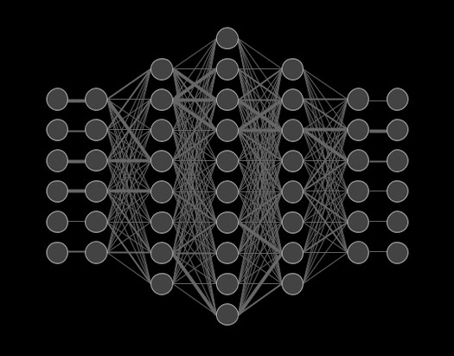
Case 3: Metis helps to deploy
 | AuTO
Latency: | 61.61ms
Coverage*: | 6%
Metis+AuTO
2.30ms
39%
Median Flows
Better
*[Alizadeh et al., SIGCOMM 2010]
Notes:
We further introduce a case of how Metis helps to deploy on the case of AuTO, which is a deep learning-based datacenter flow scheduling optimizer. The per-flow decision latency of AuTO is 62ms on average, during which 94% of short flows in data centers will run out according the statistics from DCTCP.
[Click]
Converting DNNs into decision trees enables us to make per-flow decisions for more flows with a shorter latency. In this case, Metis together with AuTO can cover 39% of flows on the same traces.
[Click]
Precise per-flow control on more flows will also improve the performance of the system. By covering more flows, Metis together with AuTO can improve the average performance by around 2% and 5% on two traces.
[Click]
More detailed analysis show that the improvement mainly comes from the optimization of those median flows, which are newly covered by Metis.

Slide 26
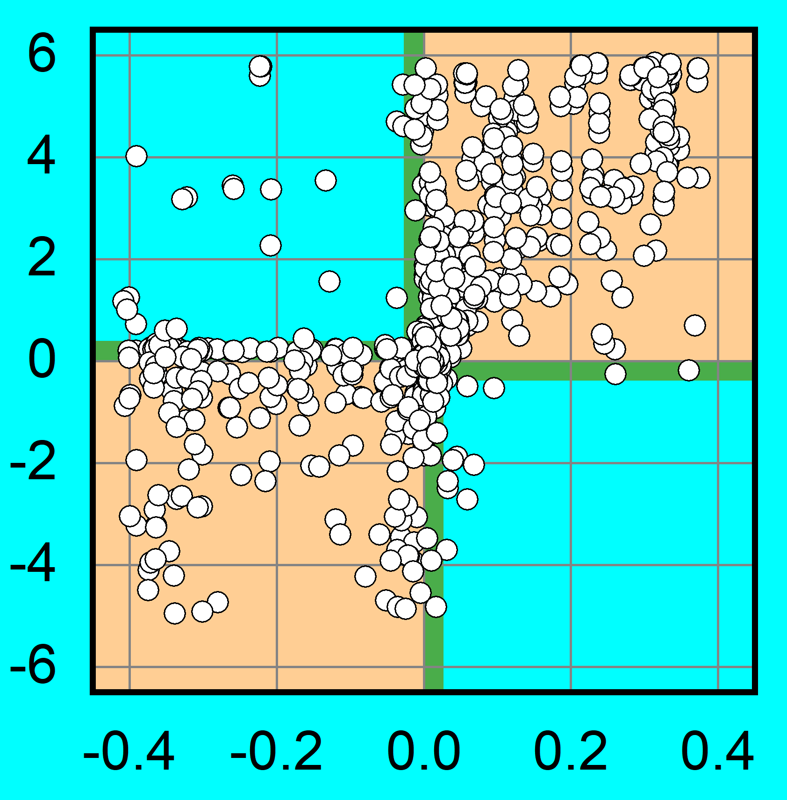
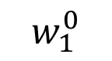
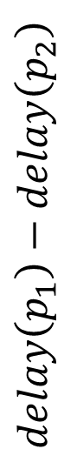
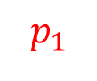
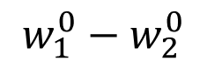
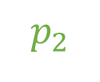
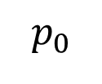
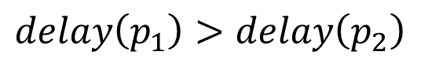
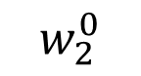
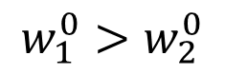
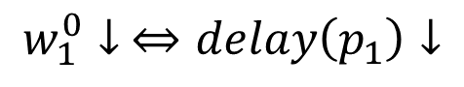
Case 4: Metis helps to ad-hoc adjust
$$p_{0}$$
$$p_{1}$$
$$p_{2}$$
a
$$w_{1}^{0}$$
$$w_{1}^{0}↓ ⇔delay\left(p_{1}\right)↓$$
$$delay\left(p_{1}\right)−delay\left(p_{2}\right)$$
b
$$w_{1}^{0}>w_{2}^{0}$$
c
…
$$w_{2}^{0}$$
…
$$delay\left(p_{1}\right)>delay\left(p_{2}\right)$$
d
$$w_{1}^{0}−w_{2}^{0}$$
e
Notes:
Finally, we have a case on how Metis helps network operators to ad-hoc adjust the RouteNet system. Suppose we have a flow from node a to node e.
[Click]
And it needs rerouting away from the original path p0, there are several candidates paths, such as p1 and p2. The actual performance of each path is unknown until rerouting rules are installed.
[Click]
Our observation is that since the candidate paths divert at different nodes from the original path, we could estimate their performance by the mask value of the connection between the diverting node and its next-hop link. For example, p1 diverts from p0 at node a. w^0_1 is the mask value of the connection between p0 and link a to b.
[Click]
Since w^0_1 represents the significance of selecting link a to b rather than other links, a lower mask value of a connection means that the selection is not critical in deciding the routing path. Therefore, lower w^0_1 value indicates that path p1 might also have a good performance.
[Click]
Therefore, we hypothesize that the relationship between w^0_1 and w^0_2 is correlated to the delay of path p1 and p2.
[Click]
We verify this observation with the dataset evaluated in RouteNet. Three quarters of points fall into the yellow quadrants with another 19% points shaded green very close to quadrants I and III. This demonstrates a strong correlation between these two pairs of values. Thus, we provide an indicator for network operators to decide which path to reroute without estimating end-to-end path latency.

Slide 27

Summary Interpreting Deep Learning-Based Networking Systems
We demonstrate the problems of existing DL-based networking systems.
Metis interprets diverse DL-based networking systems with decision trees and hypergraphs.
We implement Metis with three systems and showcase how Metis helps operators to design, debug, deploy, and ad-hoc adjust those systems.
Website: https://transys.io/metis (codes available!)
Notes:
As a summary, we first demonstrates several problems of existing deep learning-based networking systems.
[Click]
We then design Metis, which first categorizes diverse systems to local and global ones, and then interprets them with decision trees and hypergraphs.
[Click]
In our experiments, we implement Metis with three systems, Pensieve, AuTO and RouteNet, to show preliminary cases on how Metis can help network operators to design, debug, deploy, and ad-hoc adjust those deep learning-based networking systems.
[Click]
More information and the open-sourced codes can be found in our website.

Slide 28


Interpreting Deep Learning-Based Networking Systems
routing.netlab.edu.cn
zilim@ieee.org
Thank you!
Notes:
We do hope that Metis could shed light on and accelerate the deployment of deep-learning based systems in the networking community. If you have any questions, don’t hesitate to reach out to me. Thank you.

Slide 29
Interpretations – What do they look like?
Adaptive Video Streaming
(Pensieve [SIGCOMM’17])
1
8
0
3
7
11
9
4
6
13
10
12
6
Switch Flow Scheduling
(AuTO [SIGCOMM’18])
2
5
1
8
0
3
7
11
9
SDN Network Optimization
(RouteNet [SOSR’19])
10
4
6
13
10
12
2
5
9→12: 5.54
11→12: 10.88
Notes:
Here I also present the interpretations of RouteNet. For example, in the topology presented in the slide, RouteNet shows that the demand from node 6 to node 9 should follow the blue path.
[Click]
And then, Metis interprets that in the decision-making process of such a process, selecting the link from node 6 to 7 is a critical decision.
[Click]
This is mainly because, among the three potential candidate paths with similar hops, only the shortest one has the first hop of 6 to 7 while the other dashed paths have the link 6 to 4 as their first hop.
[Click]
Another example also demonstrates similar results. Metis interprets that xxx.

